Slide 1
Real-time gesture recognition for making a PC visual calculator
Guoqing YIN
Zhongchang LUO
Cyril AOUN

Slide 2
How to make a PC visual calculator 101
01
Introduction
03
Design of the calculator
Computing Logic
Interface
Project overview
Proposed structure
02
Gesture recognition model
04
Live demo
Model framework
Training
Evaluating the results

Slide 3

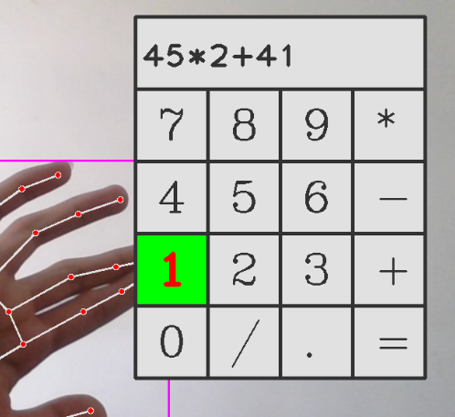
Project overview
Visual Calculator v.1.0
Gesture detection
Get the location of the finger tip
Determine whether the user is pressing the button
Record the corresponding button
Complete the operation and show the result

Slide 4

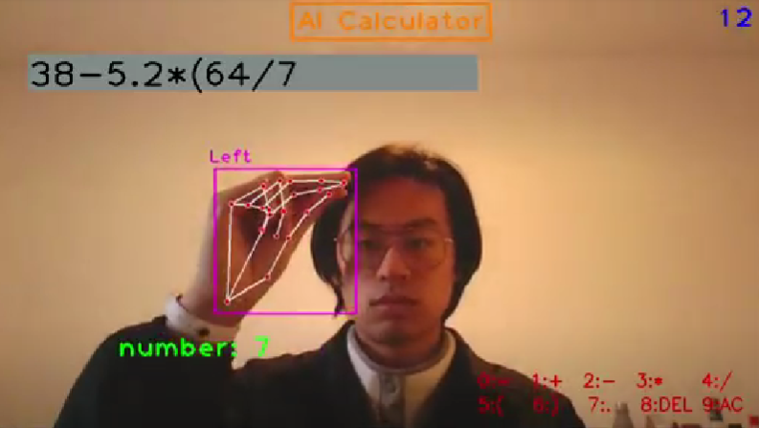
Project overview
Visual Calculator v.2.0
Don’t use keys for the calculator
Be able to use more than two digit numbers
Have all the functionalities of a traditional calculator

Slide 5
Proposed structure
Visual Calculator v.2.0
Real-time video feed
01
From a video to an input
Gesture recognition
02
Left and right hand
Number and operator
Gesture interpretation
03
What to do next?
Show the output
04
2+2 = 4

Slide 6

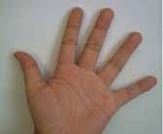
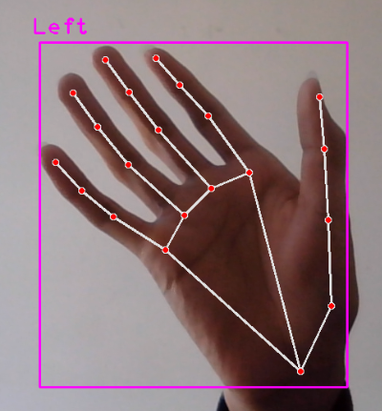
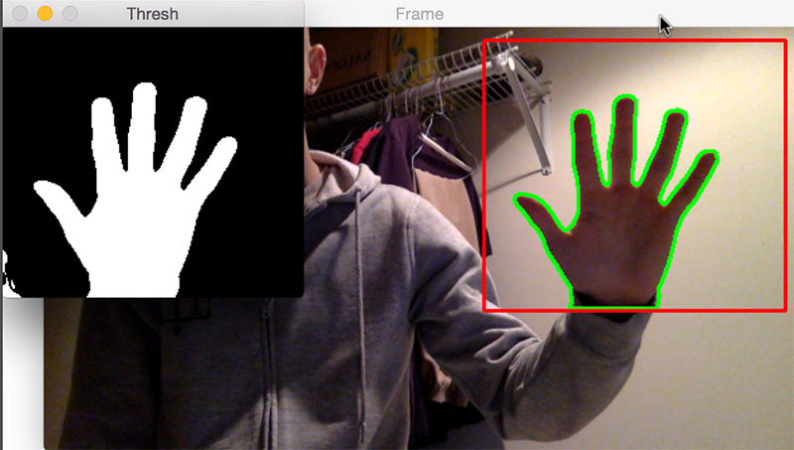
Input data type and processing
Live video to frames
RGB + CNN
Feature point detection

Slide 7
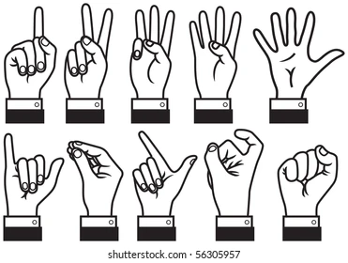
Hand gesture recognition
Left hand
Right hand
Number determination
Operator determination
1 + 2 - 3 x 4 / 5 (
6 ) 7 . 8 del 9 AC 0 =

Slide 8

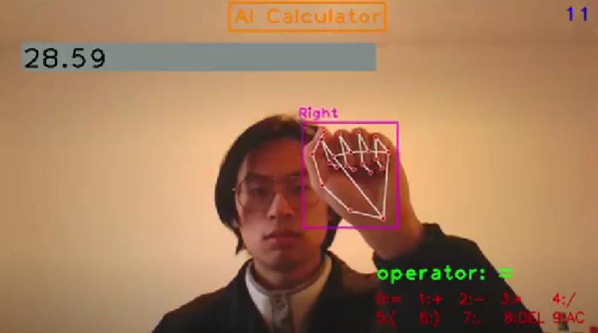
Gesture interpretation
Digit
We take a new input either another digit for the same number or an operator
Results
If operator is “=”
All operators except “ . ”
Collect the data
Hand gesture recognition
Perform the operation and either return result or move one to the next number

Slide 9

Gesture Recognition Model
CVZone
1D CNN
Number
Operator
Machine learning
Vs
It’s an application of AI
Computers observe and analyze
Predict based on previous patterns
Pre-programmed algorithms

Slide 10
Key points detection
OpenCV
Interface
CVZone
Hand type
Machine learning
Vs
3D coordinates of 21 key points
It’s an application of AI
Computers observe and analyze
Predict based on previous patterns
Pre-programmed algorithms
Mediapipe
Hand detector
Bounding box
Palm Detection Model
Hand Landmark Model

Slide 11
Gesture recognition
01
02
03
X_{n}=(X-X_{center})/width
Y_{n}=(Y-Y_{cente}r)/height
Hand type = “left”
Hand type = “right”
Map the result to number or operator
Normalization
Choose model
Output results
Machine learning
Vs
It’s an application of AI
Computers observe and analyze
Predict based on previous patterns
Pre-programmed algorithms
Model left
Recognized number
3D coordinates of 21 key points
Normalized coordinates
Bounding box
Model right
Hand type
Recognized operator

Slide 12
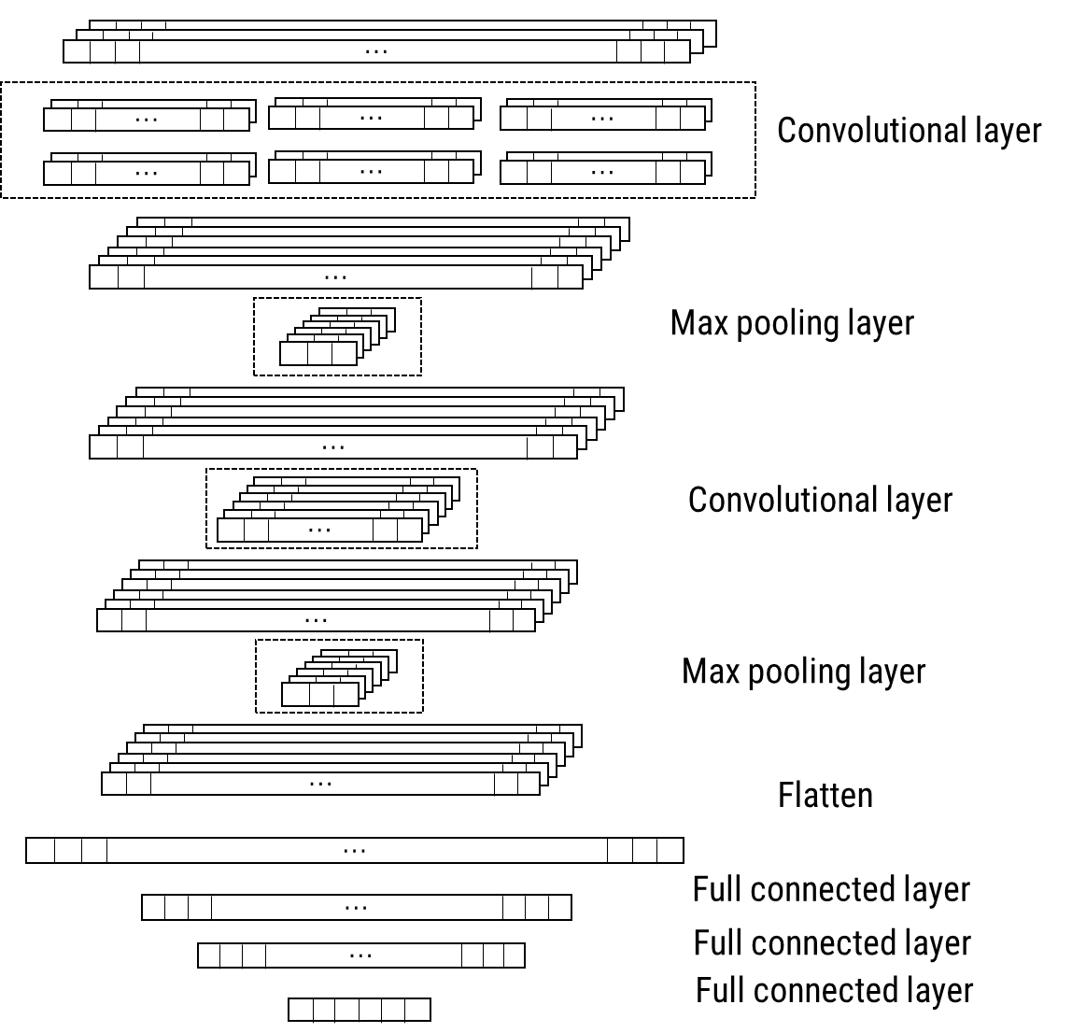
1D Convolutional Neural Network
Input: 3x21
Output: 10
Cross Entropy loss
Machine learning
Extraction of relationships and features between different key points
Vs
It’s an application of AI
Computers observe and analyze
Predict based on previous patterns
Pre-programmed algorithms

Slide 13
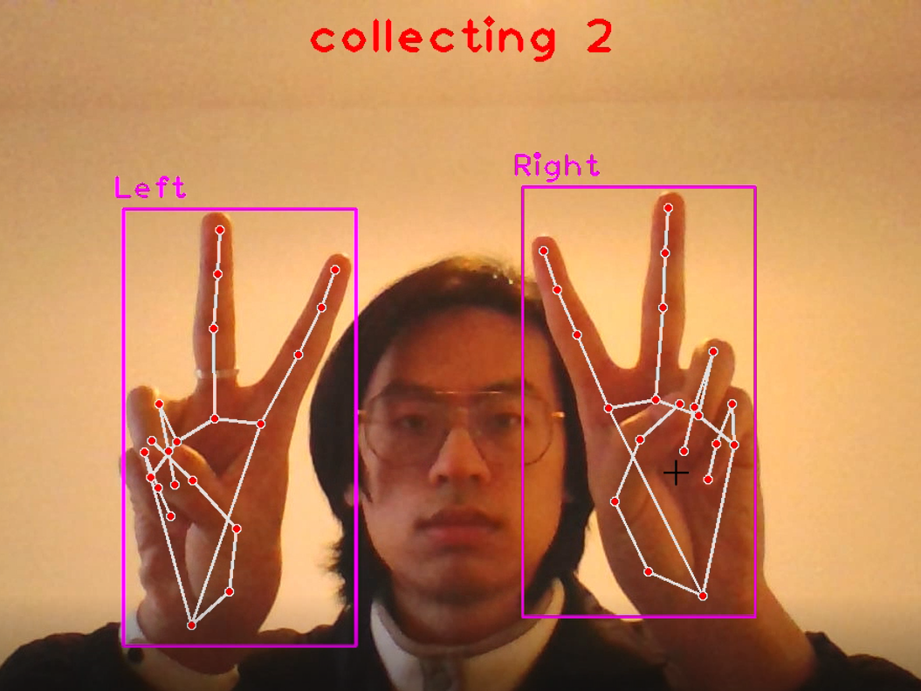
Data collection
500 × 3 = 1500 samples/hand/class
In total: 1500 × 2 × 10 = 30000 samples
Machine learning
Model | Training | Validation | Test
Left | 9000 | 3000 | 3000
Right | 9000 | 3000 | 3000
Vs
It’s an application of AI
Computers observe and analyze
Predict based on previous patterns
Pre-programmed algorithms

Slide 14
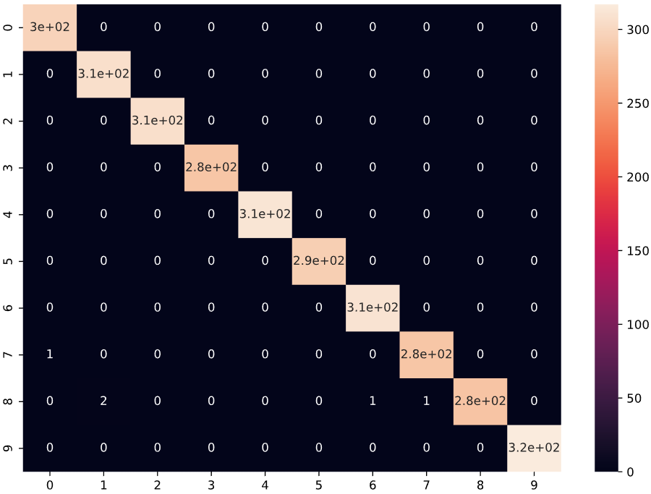
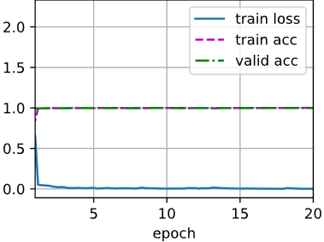
Model training and evaluation
Framework: Pytorch
Test accuracy/%
Left: 99.8%
Right: 99.9%
Model | Training accuracy/% | Validation accuracy/%
Left | 99.6 | 99.8
Right | 100 | 99.9
Machine learning
Vs
It’s an application of AI
Computers observe and analyze
Predict based on previous patterns
Pre-programmed algorithms

Slide 15
Computing Logic
Get a String
“2-3*(5+1.2)”
Left hand
Right Hand
Reverse Polish Algorithm
2
—
Output
LOOP

Slide 16
Thank you!
Computing Log

